Slide 1
Dynamic Channel Allocation for IoT Networks Using Interference-Aware Wi-Fi
👉 SYSTEMS / NETWORK OPTIMIZATION PROJECT

Slide 2
INTRODUCTION
IoT devices mostly rely on Wi-Fi (2.4 GHz) for communication
Multiple IoT nodes + routers share limited channels
Static channel selection causes:
High interference
Packet loss
Increased latency
Dynamic Channel Allocation (DCA) solves this by continuously adapting the channel based on interference

Slide 3
PROBLEM STATEMENT
Static Channel Allocation
One channel is selected at startup
Channel remains fixed even if congestion increases
Results in:
Poor throughput
Higher retransmissions
Energy wastage in IoT nodes
Need
IoT networks need self-adapting communication
Channels should change automatically when interference increases

Slide 4
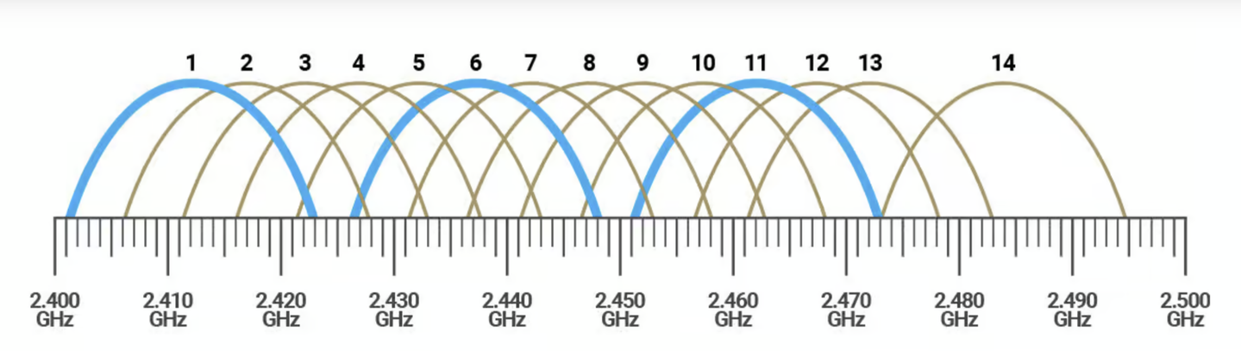
WI-FI BANDS & CHANNELS OVERVIEW
2.4 GHz Band
Total channels: 13
Only 3 non-overlapping channels: 1, 6, 11
High interference due to:
Bluetooth
Microwaves
Nearby Wi-Fi networks

Slide 5
Core Idea of the Project
Interference-Aware Dynamic Channel Allocation
IoT node does not stick to one channel
It:
Monitors current channel quality
Scans other channels
Selects the least congested channel
Switches connection without manual intervention

Slide 6
Methodology
Step 1: Initial Channel Connection
IoT device connects to a default Wi-Fi channel
Starts normal data transmission
Step 2: Continuous Monitoring
Measures:
Signal strength (RSSI)
Noise level
Packet loss
Step 3: Wait & Observe Phase
Device waits for a fixed time window
If interference stays below threshold → continue
If interference exceeds threshold → scan

Slide 7
Methodology
Step 4: Channel Scanning
Device scans all available bands
For each channel:
Checks number of active networks
Measures interference level
Computes channel score
Step 5: Free / Best Channel Detection
A channel is considered free if:
Low interference
Low network traffic

Slide 8
Methodology
Step 6: Channel Switching
If a better channel is found:
Disconnect from current channel
Reconnect to new channel
Ensures:
Minimal packet loss
Seamless communication
Step 7: Resume Data Transmission
IoT node continues normal operation
Monitoring restarts (loop)

Slide 9
Access Point (wifi)
Role:
Creates the Wi‑Fi network (DynamicAP) that all devices connect to. It starts on channel 1 and listens for HTTP commands to change the operating channel.
Key Functions:
Wi‑Fi AP Mode: Hosts a network with SSID “DynamicAP”, password ”password”.
Channel Control Endpoint: Provides /setchannel?channel=X – receives channel change commands from the controller and attempts to switch.
Status Endpoint: /status – reports the current channel to the controller (used for synchronisation).
No Channel Scanning: The AP itself does not scan; it simply follows orders from the controller.
Interaction:
Receives HTTP GET requests from the controller to change channel.
All other devices (controller, IoT node) connect to this AP

Slide 10
Central Controller
Role:
The brain of the system. Periodically scans all Wi‑Fi channels (1‑11), computes an interference score for each, decides if a channel switch is beneficial, and commands the AP to switch. It also hosts a real‑time dashboard and a UDP echo server for latency measurement.
Key Functions:
Channel Scanning: Every 30 seconds, performs a passive scan of channels 1‑11, counting APs and measuring RSSI.
Interference Scoring: Calculates a score for each channel based on:
Number of APs (1 point each)
Number of strong APs (RSSI>‑70 dBm, 2 points each)
Adjacent channel interference (±1 ch: 0.5×APs, ±2 ch: 0.25×APs)
Preference for non‑overlapping channels 1,6,11 (score multiplied by 0.8)

Slide 11
Decision Logic: Compares the best channel’s score with the current channel’s score; switches only if the best is at least 20% better.
Web Dashboard: Serves a web page at http://192.168.4.2/ showing current channel, latency, packet loss, and per‑channel scores (auto‑refresh every 5 s).
UDP Echo Server: Listens on port 8888, echoes back any received packet (used by IoT node to measure RTT).
Metrics API: /api/node-metrics accepts latency and loss reports from the IoT node (via GET or POST via Http).
JSON Status API: /api/status provides all real‑time data for the Python collector(format).
Interaction:
Sends HTTP /setchannel commands to the AP.
Receives UDP packets from the IoT node and echoes them.
Receives HTTP metrics from the IoT node.
Serves web dashboard to any connected browser.
Provides JSON data to the external Python collector.

Slide 12
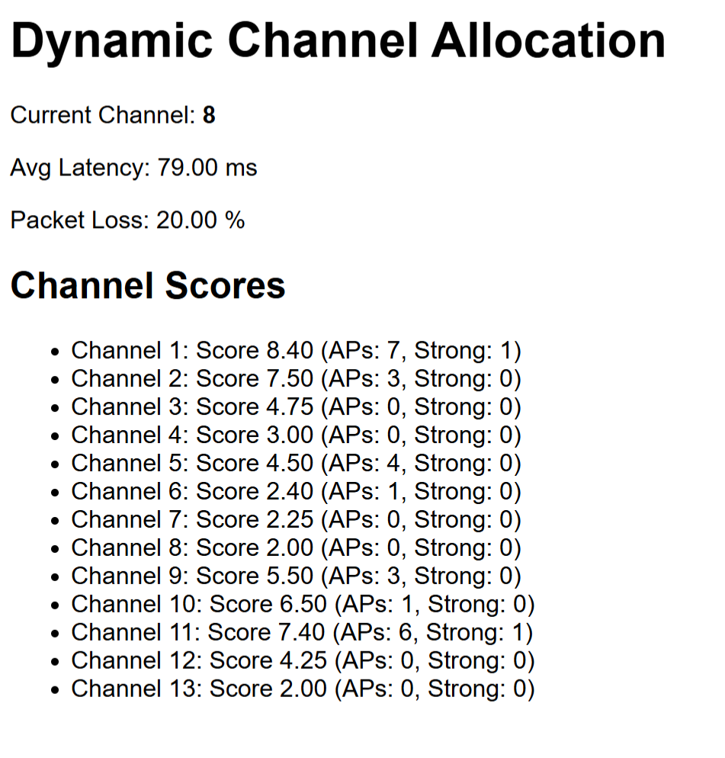
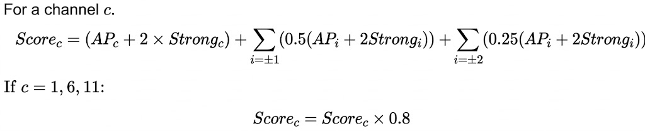
example live analysis in http

Slide 13
IoT Node
Role:
Simulates an IoT device that generates regular traffic and reports network performance metrics (latency, packet loss) back to the controller. These metrics help evaluate the impact of channel changes.
Key Functions:
UDP Traffic Generation: Every second, sends a UDP packet to the controller (port 8888) containing a sequence number and a timestamp.
Echo Detection: Listens for the echoed packet, calculates round‑trip time (RTT), and increments a counter for acknowledged packets.
Metrics Computation: Every 10 seconds, computes:
Average latency = total RTT / number of echoes received.
Packet loss (%) = (sent packets – acknowledged packets) / sent packets × 100.
HTTP Reporting: Sends the computed metrics to the controller’s /api/node-metrics endpoint (using GET with query parameters).
Static IP: Configured with IP 192.168.4.3 for reliable communication.
Interaction:
Sends UDP packets to controller and receives echoes.
Sends HTTP metrics to controller.
All traffic goes through the AP (ESP32 #1).

Slide 14
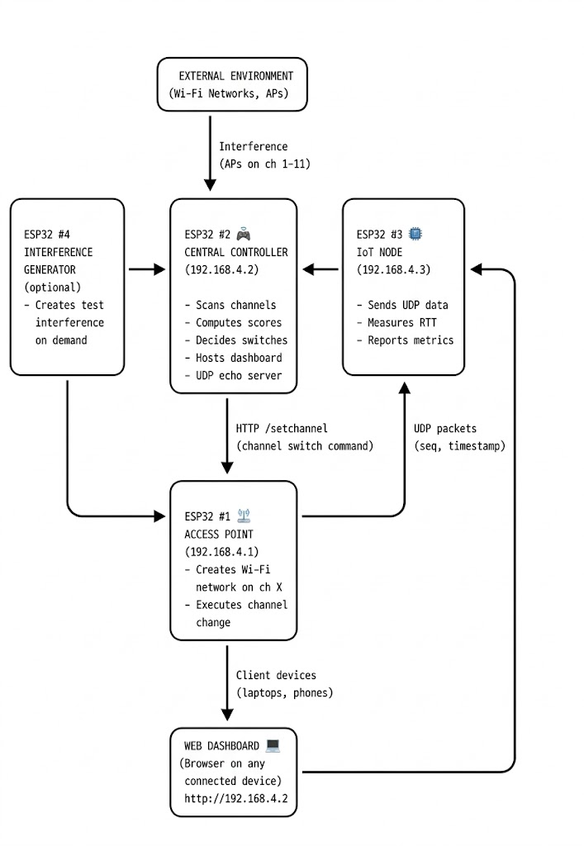
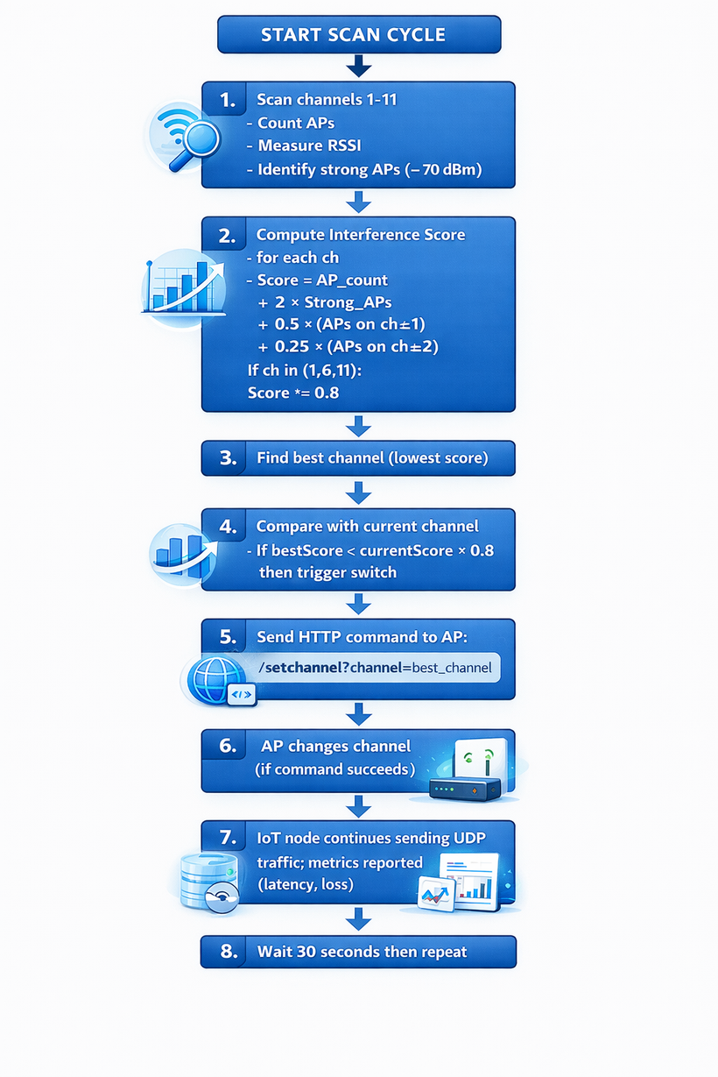
Adaptive Frequency Hopping
Flow diagram

Slide 15
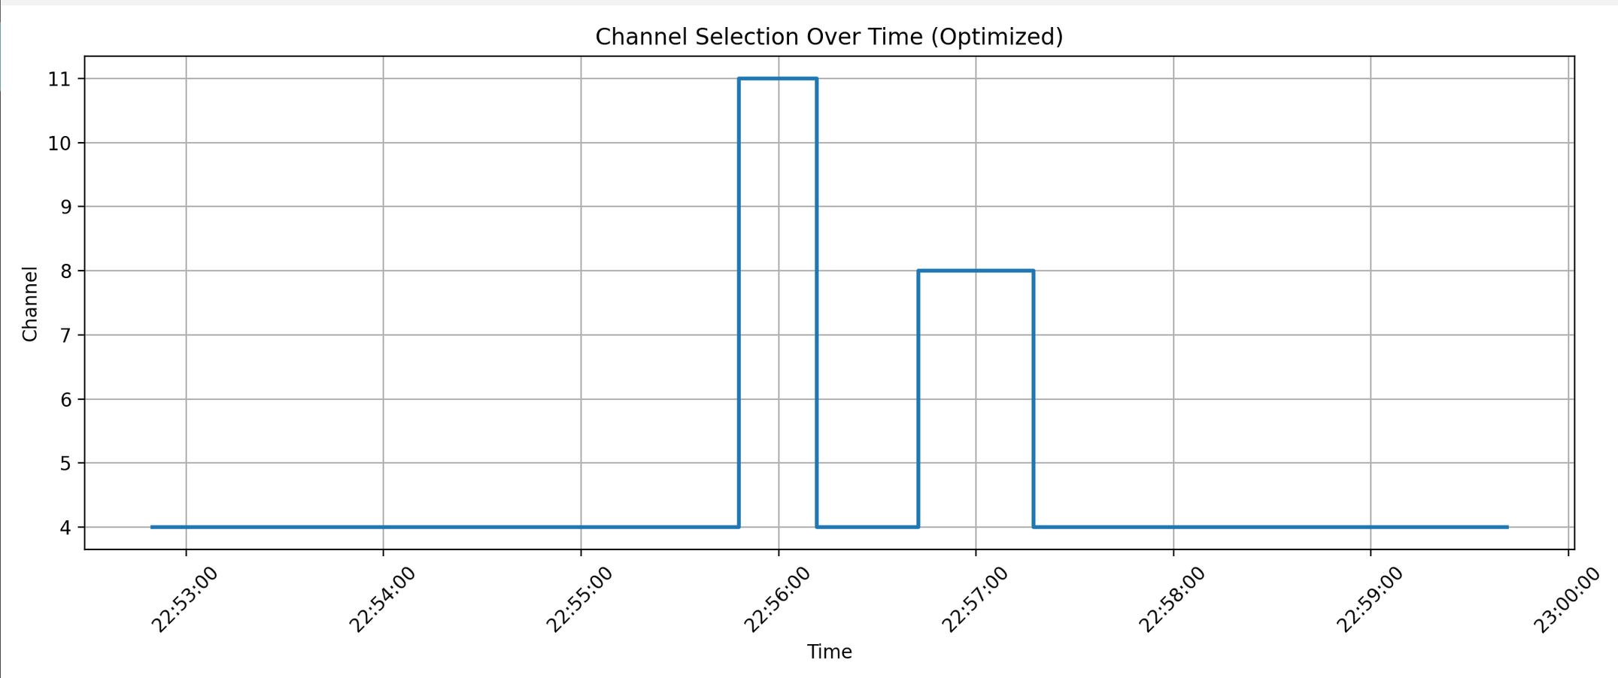
Results

Slide 16
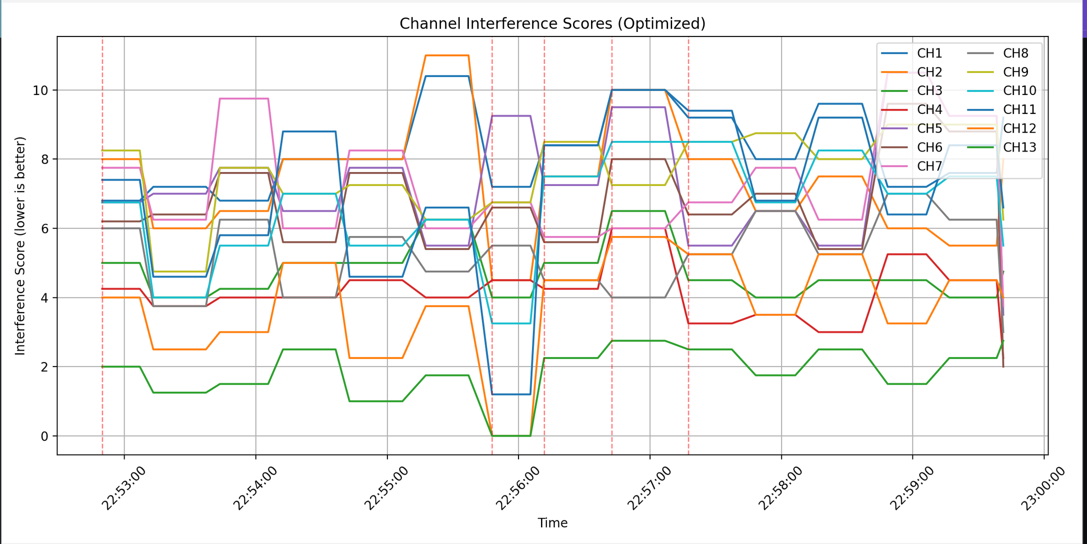

Slide 17
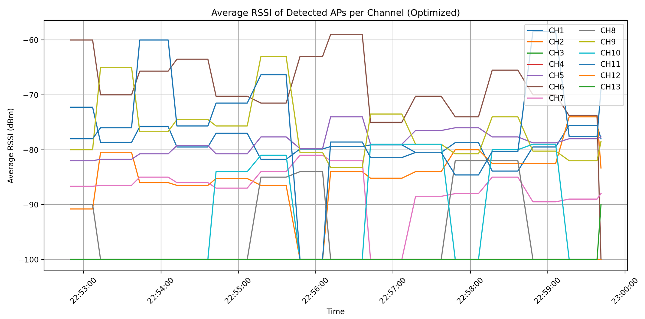

Slide 18
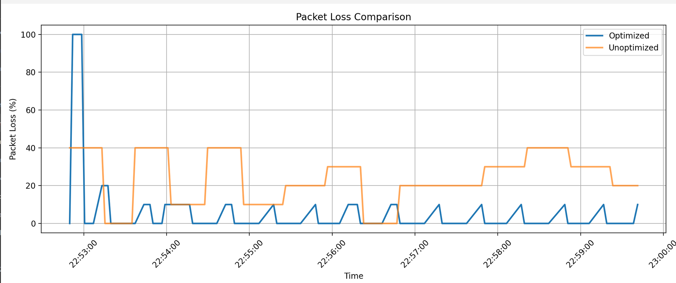

Slide 19
Advantages of Proposed System
Reduced interference
Improved throughput
Lower packet loss
Energy-efficient IoT nodes
Self-adaptive network behavior

Slide 20
Applications
Smart homes
Smart factories
IoT sensor networks
Campus Wi-Fi IoT deployment
Healthcare monitoring systems

Slide 21
Conclusion
Static channel allocation is inefficient for dense IoT networks
Interference-aware dynamic allocation improves performance
System adapts automatically to changing network conditions
Suitable for real-world IoT deployments

